Slide 2

Learning objectives
In this lesson students will learn to:
  Draw and label a diagram of the inside of a computer, label each hardware component and briefly describe its role
  Explain how the speed of the clock impacts on performance
  Explain how pipelining improves the performance of the CPU.
For more details on this topic and additional student activities see Topic 3 of the student book.
© Pearson Education Ltd 2020. Copying permitted for purchasing institution only.
Notes:
Specification content: 3.1.1

Slide 3
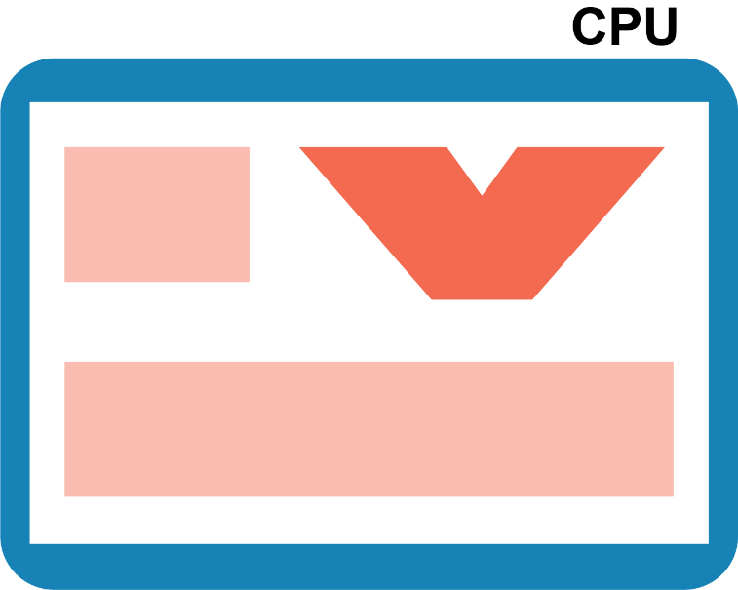
Starter - recap
Name at least three components inside a CPU – try to answer this!
  What is the purpose of each component?
RAM

Slide 4
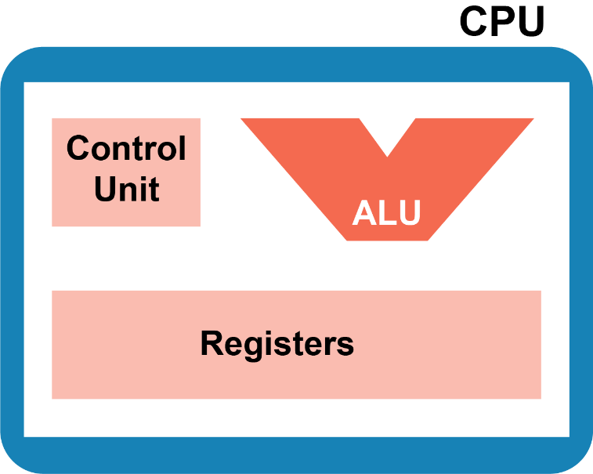
Starter
Components in a CPU
  Control unit (CU) – decodes the instructions; controls the timing of operations in the CPU
  Arithmetic Logic Unit (ALU) –
  performs arithmetic and
  logic operations
  Registers – store data, instructions
  and the results of calculations

Slide 5
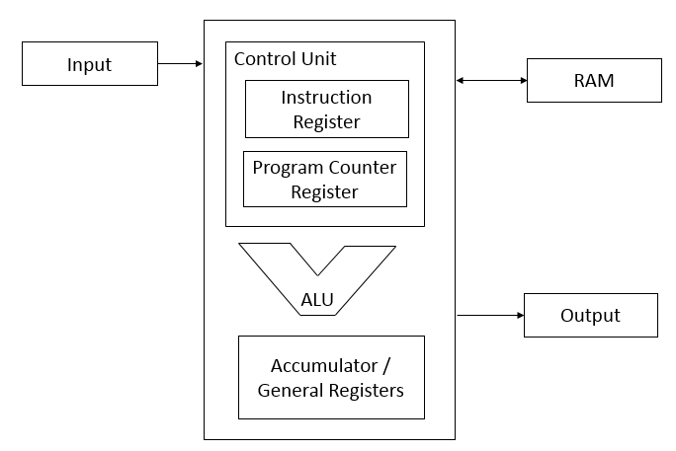
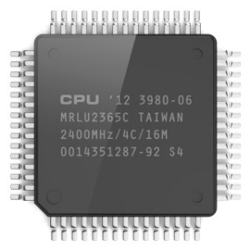
Central Processing Unit
The CPU - 'brain of the computer’.
It is the hardware component responsible for all the processing that the computer carries out.
Its job is to process data. By processing, we mean things such as searching, sorting, calculating and decision making.
Whenever you are on working on your computer, it is the CPU that is at the centre of everything.
© Pearson Education Ltd 2020. Copying permitted for purchasing institution only.
Notes:
The giving of human qualities to a machine, called ‘anthropomorphism’, is something you need to be very careful about doing in the context of computers. In this example, the ‘brain’ means the ‘centre of processing’. It does not mean that a machine can think or reason. Ensure that other qualities of the human brain are not attributed to machines by making this difference clear.

Slide 6
Control unit
The control unit receives signals from other parts of the computer system and sends signals to them.
It is responsible for handling hardware interrupts (e.g. inputs from a mouse, keyboard, network, etc.).
It is responsible for fetching, decoding, and executing instructions.
It is the powerhouse of the CPU – it has the most responsibility.
© Pearson Education Ltd 2020. Copying permitted for purchasing institution only.
Notes:
The CU is much like the conductor in an orchestra. As in an orchestra, there are lots of instruments, which all play a part when called upon, but only when the conductor dictates.

Slide 7
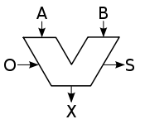
Arithmetic logic unit
The Arithmetic Logic Unit (ALU) performs actual operations on data.
  Arithmetic: + / = *
  Logic: AND, OR, NOT, etc.
It is able to compare numbers against 0.
It can test if two numbers are equal.
It uses logic gates in combination to perform operations.
© Pearson Education Ltd 2020. Copying permitted for purchasing institution only.
Notes:
Students may have already been doing arithmetic and Boolean logic (AND, OR, NOT) in their programs. Physical logic gates implement the truth tables found in Topic 1.
O = opcode to perform; S = status after operation; A, B = operands (data); X = result. Students should be familiar with the symbol, but not the arguments.

Slide 8
Registers
Also known as immediate access storage.
Registers are a type of memory that is extremely fast, much faster than RAM.
Each type of processor has different registers that are designed to hold different information.
Most processors have:
  an instruction register: holds instruction currently being executed by the CPU.
  an accumulator: holds the accumulated result of operations carried out by the ALU.
  a program counter: holds the memory address of the next instruction to be executed.
© Pearson Education Ltd 2020. Copying permitted for purchasing institution only.
Notes:
Student Activity 1

Slide 9
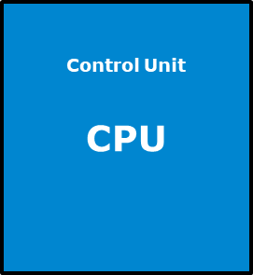
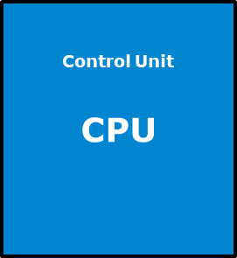


Clock speed
Everything in a computer happens on the pulse of the internal clock
  Therefore, the faster the clock speed, the faster the instructions are processed
Clock speed 1GHz
Clock speed 2GHz
Clock
Clock

Slide 10
Processor Speed
One cycle per second = 1 hertz (Hz) = 1 instruction carried out each second
1 kilohertz (kHz) = 1000 cycles per second
1 Megahertz (MHz) = 1,000,000 cycles per second
1 Gigahertz (GHz) = 1,000,000,000 cycles per second
  How fast is your computer’s processor?
  Remember, a 1 GHz processor is performing one billion cycles per second

Slide 11
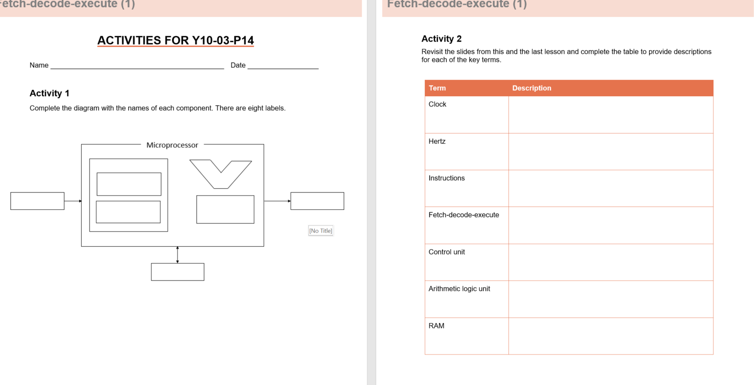
Now complete the worksheet
Save the worksheet and send the completed version to me via SMH at end of lesson

Slide 12
Wrap up: you have learned how to…
Draw and label a diagram of the inside of a computer, label each hardware component and briefly describe its role.
  CPU contains the ALU, CU and registers.
  The other components a computer needs include: input and output devices, RAM, motherboard, and power supply unit.
Explain how the speed of the clock impacts on performance.
  The faster the clock speed, the more instructions can be carried out per second.
© Pearson Education Ltd 2020. Copying permitted for purchasing institution only.

